Slide 1

Image Recognition system
Weather Image Recognition System
Presented by:
Akshay Reddy Gone
Vishal Balaji Kotrike
Yeswanth Reddy Chereddy

Slide 2
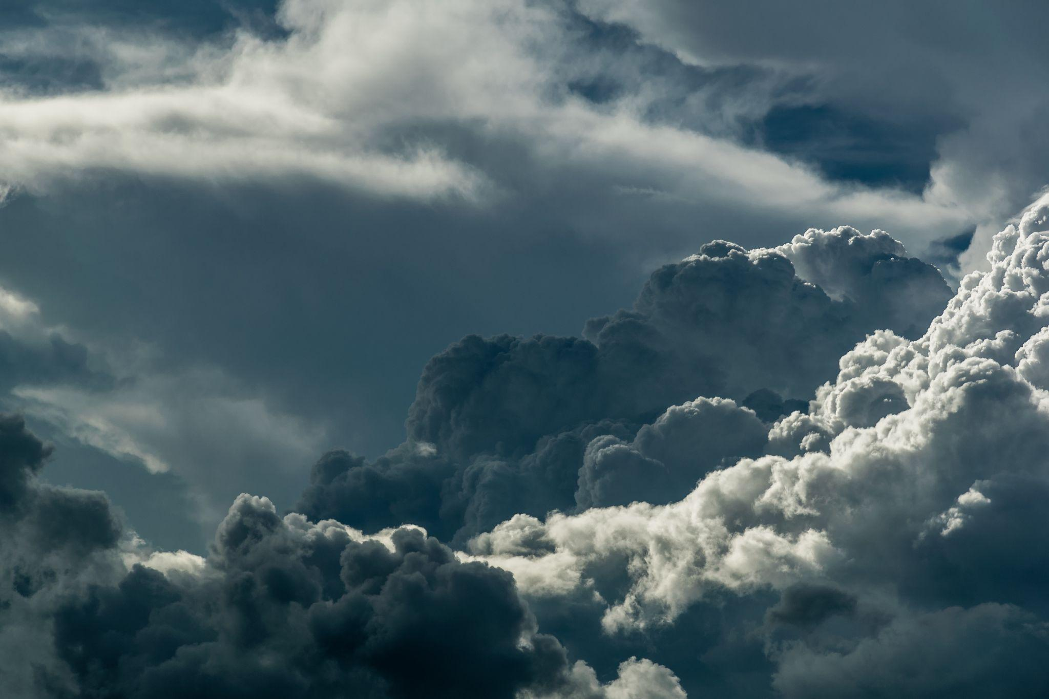
INTRODUCTION:
In today's rapidly evolving technological landscape, harnessing the power of artificial intelligence and computer vision has opened up new avenues in weather analysis and forecasting.
Our project focuses on developing a cutting-edge system capable of autonomously analyzing various weather-related images, enabling us to extract critical information for enhanced meteorological insights.
Our Weather Image Recognition System leverages state-of-the-art imaging technologies, including satellite imagery, radar scans, and other specialized sensors, to provide a comprehensive and detailed view of weather patterns and phenomena.

Slide 3

Dataset Information:
The Weather Dataset is a comprehensive collection of weather-related data that encompasses various parameters and features, including temperature, humidity, wind speed, atmospheric pressure, and more.
Source: Kaggle Datasets Dataset
Title: Weather Dataset
Provider: Jehan Bhatena
Link to Dataset: https://www.kaggle.com/datasets/jehanbhathena/weather-dataset

Slide 4

TOOLS TO BE USED:
Mongo dB
Apache Spark (PySpark)
Jupyter Notebook
Tableau

Slide 5
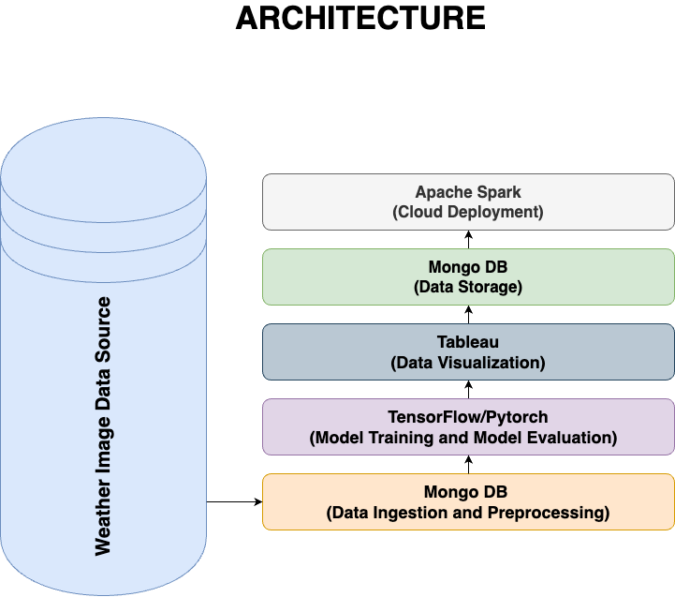
Notes:
Data Ingestion: Collect and store weather images in a central repository for analysis.
Preprocessing: Normalize and augment image data for consistency and improved model training.
Model Training: Utilize deep learning frameworks to train Convolutional Neural Networks (CNNs) on the Weather Dataset.
Model Evaluation: Assess model accuracy and performance, fine-tuning as needed.
Real-Time Image Processing: Implement live image processing for real-time weather analysis and continuous monitoring.
Results and Insights: Generate weather predictions and insights, displaying analyzed data through visualizations.
Disaster Response: Provide critical information for disaster management and response.
User Interface: Develop user-friendly interfaces for accessing and visualizing weather data.
Data Storage: Store historical and processed data, utilizing MongoDB for efficient data management.
Reporting and Monitoring: Monitor system performance, generate reports for meteorologists and users.
Cloud Deployment: Deploy on cloud infrastructure for scalability, using Apache Spark for distributed image processing.
Tableau Dashboard: Create interactive Tableau dashboards for data visualization.
Benefits: Achieve improved forecasting accuracy, real-time weather updates, continuous learning, and enhanced disaster management.
This overview summarizes the main functionalities of each component in the system's architecture.

Slide 6

Illustration:
Our Weather Image Recognition System is depicted as a simplified diagram with key components. It starts with Data Ingestion, where weather images are collected. Preprocessing prepares these images for analysis, followed by Model Training using deep learning frameworks. Model Evaluation assesses accuracy and performance. Real-Time Image Processing enables live weather analysis.
Results and Insights generate predictions and visualizations. Disaster Response provides critical information for disaster management. User Interface offers user-friendly access. Finally, Data Storage stores historical and processed data, and Reporting and Monitoring monitor system performance.

Slide 7
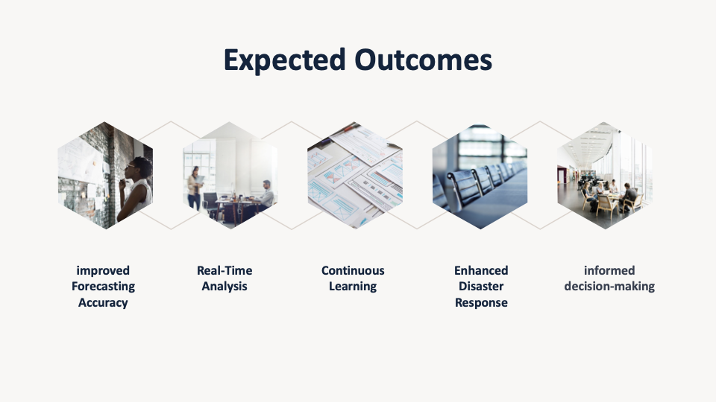

Slide 8

References:
“Weather Dataset Source(Kaggle)” by Jehan Bhatena: https://www.kaggle.com/datasets/jehanbhathena/weather-dataset
“Image Segmentation on Apache Spark” by Geraldo Souza: https://towardsdatascience.com/image-segmentation-on-apache-spark-46164dd53c73
“Deep Learning for Image Classification” by John Smith: https://viso.ai/computer-vision/image-classification/
“Weather Image Analysis Techniques” by Zenghui Wang:
https://dl.acm.org/doi/fullHtml/10.1145/3556677.3556688
“Image Recognition in Weather Forecasting” by Mohammad Farid Naufal:https://pubs.aip.org/aip/acp/article-abstract/2470/1/050004/2825757/Weather-image-classification-using-convolutional?redirectedFrom=fulltext

Slide 9


